Slide 1


JAVASCRIPT OBJECTS

Slide 2

Object Definitions
In Javascript everything is an object.
A JavaScript object is a collection of named values.
Booleans can be objects (if defined with the new keyword)
Numbers can be objects (if defined with the new keyword)
Strings can be objects (if defined with the new keyword)
Dates are always objects
Maths are always objects
Regular expressions are always objects
Arrays are always objects
Functions are always objects
Objects are always objects
In javascript all are objects except Primitive data types.

Slide 3
Object Definitions
Javascript variables can contain single values
let person = “Alexa”;
But objects can contain many values
Object values are written as name : value pairs
let person = {firstname : “John”, lastname : “Doe”, age : 50, eyeColor : “blue”};

Slide 4
Object Definitions
Real Life Objects, Properties, and Methods
A car is an object.
→A car has properties like weight and color, and methods like start and stop:
Properties Methods
car.name=Fiat car.start()
car.model=500 car.drive()
car.weight=850kg car.brake()
car.color=white car.stop()

Slide 5
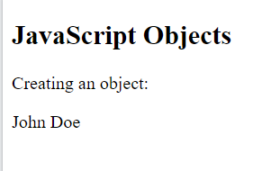
Example - Objects
Example
<html>
<body>
<h2>JavaScript Objects</h2>
<p>Creating an object:</p>
<p id="demo"></p>
<script>
let person = {
firstName : "John",
lastName : "Doe",
age : 50,
eyeColor : "blue"
};
document.getElementById("demo").innerHTML = person.firstName + " " + person.lastName;
</script>
</body>
</html>

Slide 6
Object Properties
The named values, in JavaScript objects are called Properties.
Property – Firstname, Lastname, age, Eyecolor
Value – John, Doe, 50, blue

Slide 7
Object Methods
Object Methods
Methods are actions that can be performed on objects.
An object method is an object property containing a function definition.
Example
const person = {
firstName: "John",
lastName: "Doe",
id: 5566,
fullName: function() {
return this.firstName + " " + this.lastName;
}
}

Slide 8
Creating Own Objects
In JavaScript we can create and our own objects
Ways to create our own object.
1. Create a single object, using an object literal. They are comma separated values. Those values can be properties and functions
Example: var person = { fullname: "Michael Jackson", age: 50; };
var person={};
person.fullname=“Michael Jackson”;
person.age=50;

Slide 9
Creating Own Objects
2. Create a single object, function constructor with the keyword new.
function myfun() {
this.x=100; }
var obj1=new myfun();
console.log(obj1.x);
3. Define an object constructor, and then create objects of the constructed type
var person= new object();
person.name=“Sandy”;
4. Create an object using Object.create()
const obj = object.create(newobject);

Slide 10
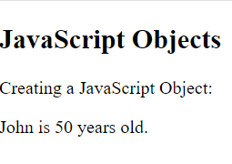
Example – Object Literals
<html>
<body>
<h2>JavaScript Objects</h2>
<p>Creating a JavaScript Object:</p>
<p id="demo"></p>
<script>
const person = {firstName:"John", lastName:"Doe", age:50,eyeColor:"blue"};
document.getElementById("demo").innerHTML =
person.firstName + " is " + person.age + " years old.";
</script>
</body>
</html>
<html>
<body>
<h2>JavaScript Objects</h2>
<p>Creating a JavaScript Object:</p>
<p id="demo"></p>
<script>
const person = {firstName:"John", lastName:"Doe", age:50,eyeColor:"blue"};
document.getElementById("demo").innerHTML =
person.firstName + " is " + person.age + " years old.";
</script>
</body>
</html>

Slide 11
Example – Object Literals – empty object
<html>
<body>
<h2>JavaScript Objects</h2>
<p>Creating a JavaScript Object:</p>
<p id="demo"></p>
<script>
const person = {};
person.firstName = "John";
person.lastName = "Doe";
person.age = 50;
person.eyeColor = "blue";
document.getElementById("demo").innerHTML =
person.firstName + " is " + person.age + " years old.";
</script>
</body></html>

Slide 12
Example – using Keyword
<html>
<body>
<h2>JavaScript Objects</h2>
<p>Creating a JavaScript Object:</p>
<p id="demo"></p>
<script>
const person = new Object();
person.firstName = "John";
person.lastName = "Doe";
person.age = 50;
person.eyeColor = "blue";
document.getElementById("demo").innerHTML =
person.firstName + " is " + person.age + " years old.";
</script>
</body></html>

Slide 13
Objects - Mutable
Objects are mutable. They are addressed by reference and not by Values
For Example:
If person is an object, then the below syntax code will not create a copy of the object person. It is a person.
In simple words, we can say that both x and person are the same object.
const person = {
firstName: "John",
lastName: "Doe",
};
const x=person;

Slide 14
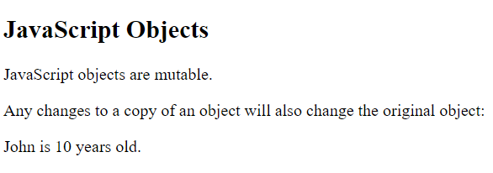
Objects - Mutable
<html>
<body>
<h2>JavaScript Objects</h2>
<p id="demo"></p>
<script>
const person = {
firstName: "John",
lastName: "Doe",
age:50,
eyeColor: "blue"
};
const x = person;
x.age = 10;
document.getElementById("demo").innerHTML =
person.firstName + " is " + person.age + " years old.";
</script></body></html>

Slide 15
JavaScript Object Properties
Properties are the values associated with Javascript
A Javascript object is a collection of unordered properties
Properties can usually be changed, added and deleted but some are read only
Syntax:
objectName.property // person.age
objectName["property"] // person["age"]
objectName[expression] // x = "age"; person[x]

Slide 16
JavaScript Math Object
Math object allows us to perform mathematical tasks on numbers.
It is not a constructor, so you cannot create Math instances. Instead, you access its properties and methods directly as static members.
Syntax: Math. property.
Example : Math.PI;
JavaScript provides 8 mathematical constants that can be accessed as Math properties:

Slide 17
Math Properties
Math.E - return Euler’s number – 2.71828
Math.PI - returns PI
Math.SQRT2 - returns the square root of 2
Math.SQRT1_2 - returns the square root of 1/2
Math.LN2 - returns the logarithm of 2
Math.LN10 - returns the logarithm of 10
Math.LOG2E - returns base 2 logarithm of E
Math.LOG10E - returns base 10 logarithm of E

Slide 18
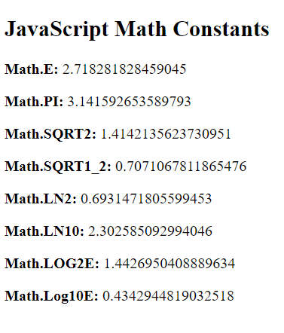
Math Properties
<html>
<body>
<h2>JavaScript Math Constants</h2>
<p id="demo"></p>
<script>
document.getElementById("demo").innerHTML =
"<p><b>Math.E:</b> " + Math.E + "</p>" +
"<p><b>Math.PI:</b> " + Math.PI + "</p>" +
"<p><b>Math.SQRT2:</b> " + Math.SQRT2 + "</p>" +
"<p><b>Math.SQRT1_2:</b> " + Math.SQRT1_2 + "</p>" +
"<p><b>Math.LN2:</b> " + Math.LN2 + "</p>" +
"<p><b>Math.LN10:</b> " + Math.LN10 + "</p>" +
"<p><b>Math.LOG2E:</b> " + Math.LOG2E + "</p>" +
"<p><b>Math.Log10E:</b> " + Math.LOG10E + "</p>";
</script>
</body>
</html>

Slide 19
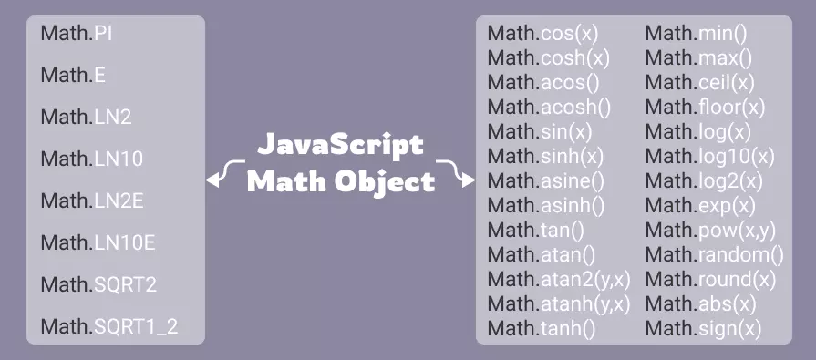
JavaScript Math Object
Math Methods
Syntax : Math.method(number)
4 common methods to round a number to an integer:
Math.round(x)→Returns x rounded to its nearest integer
Math.ceil(x) →Returns x rounded up to its nearest integer
Math.floor(x) → Returns x rounded down to its .
trunc(x) → Returns the integer part of (new in ES6)
sign(x) → Returns if x is negative or positive
Example:Math.round(4.6); - result : 5
Math.ceil(4.9); - result : 5
Math.trunc(4.9); - result : 4

Slide 20
JavaScript Strings
Strings are for storing and manipulating text.
String is zero or more characters written inside quotes.
Use single or double quotes:
Example:
let carName1 = "Volvo XC60"; // Double quotes let carName2 = 'Volvo XC60'; // Single quotes let answer1 = "It's alright"; let answer2 = "He is called 'Johnny'"; let answer3 = 'He is called "Johnny"';
String Length
To find the length of a string, use the built-in length property:
Example:
let text = "ABCDEFGHIJKLMNOPQRSTUVWXYZ"; let length = text.length;
Escape Character
The backslash (\) escape character turns special characters into string characters:
Code Result Description
\‘ ‘ Single quote
\“ “ Double quote
\\ \ Backslash
The sequence \" inserts a double quote in a string:
Example:
let text = "We are the so-called \"Vikings\" from the north.";
let text= 'It\'s alright.';
let text = "The character \\ is called backslash.";

Slide 21
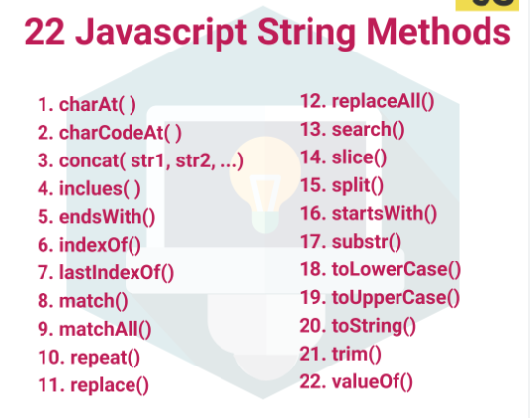
JavaScript Strings

Slide 22
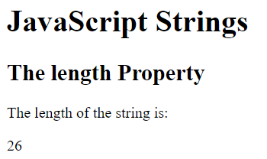
JavaScript Strings
Length Property
<html>
<body>
<h1>JavaScript Strings</h1>
<h2>The length Property</h2>
<p>The length of the string is:</p>
<p id="demo"></p>
<script>
let text = "ABCDEFGHIJKLMNOPQRSTUVWXYZ";
document.getElementById("demo").innerHTML = text.length;
</script>
</body>
</html>

Slide 23
Extracting String Parts
There are three methods for extracting a part of a String:
slice(start, end)
substring(start, end)
substr(start,length)
Slice() extracts a part of a String and returns the extracted part in a new string
The method takes two parameters: start position and end position.

Slide 24
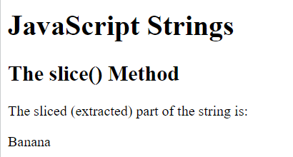
Slicing
<html>
<body>
<h1>JavaScript Strings</h1>
<h2>The slice() Method</h2>
<p>The sliced (extracted) part of the string is:</p>
<p id="demo"></p>
<script>
let text = "Apple, Banana, Kiwi";
let part = text.slice(7,13);
document.getElementById("demo").innerHTML = part;
</script>
</body>
</html>

Slide 25
Slicing
let text = "Apple, Banana, Kiwi";
let part = text.slice(7,13); Output : Banana
let part = text.slice(7); Output : Banana, Kiwi
let part = text.slice(-12) Output: Banana, Kiwi

Slide 26
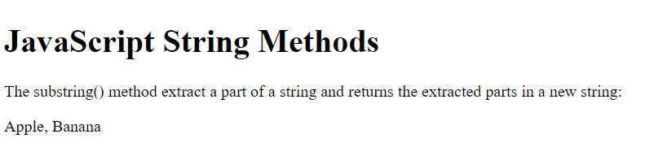
JavaScript String substring()
The start and end value less than 0 are treated as 0 in substring()
<html>
<body>
<h1>JavaScript String Methods</h1>
<p>The substring() method extract a part of a string and returns the extracted parts in a new string:</p>
<p id="demo"></p>
<script>
let str = "Apple, Banana, Kiwi";
document.getElementById("demo").innerHTML = str.substring(1,13);
</script>
</body>
</html>

Slide 27
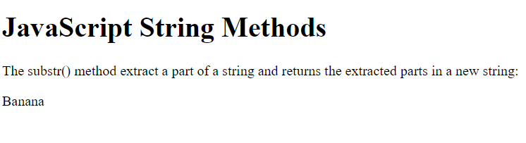
JavaScript String substr()
The second parameter specifies the length of the extracted part
<html>
<body>
<h1>JavaScript String Methods</h1>
<p>The substr() method extract a part of a string
and returns the extracted parts in a new string:</p>
<p id="demo"></p>
<script>
let str = "Apple, Banana, Kiwi";
document.getElementById("demo").innerHTML = str.substr(7,6);
</script>
</body>
</html>

Slide 28
JavaScript String Methods
String slice() → extracts a part of a string and returns the extracted part in a new string.
String substring() →substring() is similar to slice().The difference is that start and end values less than 0 are treated as 0 in substring().
String substr() →substr() is similar to slice(). The difference is that the second parameter specifies the length of the extracted part.
String replace() →replaces a specified value with another value in a string, case sensitive.
String replaceAll() →to specify a regular expression instead of a string to be replaced.
String toUpperCase() →A string is converted to upper case with toUpperCase().
String toLowerCase() →A string is converted to lower case with toLowerCase().

Slide 29
JavaScript String Methods
String concat() →concat() joins two or more strings
String trim() →removes whitespace from both sides of a string
String trimStart() →removes whitespace only from the start of a string
String trimEnd() →removes whitespace only from the end of a string
String padStart() →to support padding at the beginning
String padEnd() →at the end of a string.
String charAt() →returns the character at a specified index (position) in a string
String charCodeAt() →returns the Unicode of the character at a specified index in a string
String split() → A string can be converted to an array with the split() method

Slide 30
JavaScript String Methods
String indexOf() → returns the index of (position of) the first occurrence of a string in a string
String lastIndexOf() → returns the index of the last occurrence of a specified text in a string
String search() → searches a string for a string (or a regular expression) and returns the position of the match
String match() → returns an array containing the results of matching a string against a string (or a regular expression)
String matchAll() → returns an iterator containing the results of matching a string against a string (or a regular expression).
String includes() → returns true if a string contains a specified value
String startsWith() → returns true if a string begins with a specified value
String endsWith() → returns true if a string ends with a specified value

Slide 31
JavaScript String Search-Example
let text = "Please locate where 'locate' occurs!"; text.indexOf(“locate"); Output : 7
let text = "Please locate where 'locate' occurs!"; text.lastIndexOf("locate"); Output : 21
let str = "Please locate where 'locate' occurs!"; str.search(/locate/); Output : 7
let text = "The rain in SPAIN stays mainly in the plain"; text.match(/ain/); Output : 1 ain
let text = "I love cats. Cats are very easy to love. Cats are very popular."
const iterator = text.matchAll(/Cats/g); Output : Cats, Cats
let text = "Hello world, welcome to the universe."; text.includes("world", 12); Output : false
let text = "Hello world, welcome to the universe."; text.endsWith("world", 11); Output : true

Slide 32
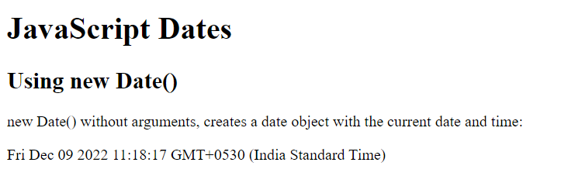
Date Methods
<html>
<body>
<h1>JavaScript Dates</h1>
<h2>Using new Date()</h2>
<p>new Date() without arguments, creates a date object with the current date and time:</p>
<p id="demo"></p>
<script>
const d = new Date();
document.getElementById("demo").innerHTML = d;
</script>
</body>
</html>

Slide 33
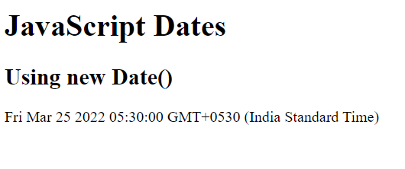
Date Methods
<html>
<body>
<h1>JavaScript Dates</h1>
<h2>Using new Date()</h2>
<p id="demo"></p>
<script>
const d = new Date("2022-03-25");
document.getElementById("demo").innerHTML = d;
</script>
</body>
</html>

Slide 34
Date Methods
Creating Date Objects
Date objects are created with the new Date() constructor.
There are 9 ways to create a new date object:
new Date() new Date(date string) new Date(year,month) new Date(year,month,day) new Date(year,month,day,hours) new Date(year,month,day,hours,minutes) new Date(year,month,day,hours,minutes,seconds) new Date(year,month,day,hours,minutes,seconds,ms) new Date(milliseconds)
new Date(date string) creates a date object from a date string
const d = new Date("October 13, 2014 11:13:00");
new Date(year, month, ...)
new Date(year, month, ...) creates a date object with a specified date and time.
const d = new Date(2018, 11, 24, 10, 33, 30, 0);
new Date(milliseconds)
new Date(milliseconds) creates a new date object as milliseconds plus zero time:
const d = new Date(24 * 60 * 60 * 1000); // or
const d = new Date(86400000);
const d = new Date(); d.toUTCString();
const d = new Date(); d.toISOString();

Slide 35
JavaScript Date Formats
const d = new Date("October 13, 2014 11:13:00"); Output : Mon Oct 13 2014 11.13..00 GMT +0530(IST)
const d = new Date("2022-03-25"); Output: Fri Mar 25 2022 11.13..00 GMT +0530(IST)
const d = new Date(2018, 11, 24, 10, 33, 30, 0); Output : Mon Dec 24 2018 10:33:30 GMT+0530 (IST)
const d = new Date(2018, 15, 24, 10, 33, 30, 0); // month >11 Output: Wed Apr 24 2019 10:33:30 GMT+0530 (IST)

Slide 36
JavaScript Date Formats
There are generally 3 types of JavaScript date input formats:
Type Example
ISO Date "2015-03-25" (The International Standard)
Short Date "03/25/2015“
Long Date "Mar 25 2015" or "25 Mar 2015“
JavaScript Date Output
Sat Dec 03 2022 19:24:55 GMT+0530 (India Standard Time)
JavaScript ISO Dates
ISO 8601 is the international standard for the representation of dates and times.
The ISO 8601 syntax (YYYY-MM-DD) is the preferred JavaScript date format
ISO Dates (Year and Month)
SO dates can be written without specifying the day (YYYY-MM):→ const d = new Date("2015-03");
ISO Dates (Date-Time)
ISO dates can be written with added hours, minutes, and seconds (YYYY-MM-DDTHH:MM:SSZ):
const d = new Date("2015-03-25T12:00:00Z");
JavaScript Short Dates.
Short dates are written with an "MM/DD/YYYY" syntax like this: →const d = new Date("03/25/2015");
JavaScript Long Dates.
Long dates are most often written with a "MMM DD YYYY" syntax like this:
→const d = new Date("Mar 25 2015");

Slide 37
JavaScript Date Formats
If you had a valid date string, you can use the Date.parse() method to convert it to milliseconds
Date Input - Parsing Dates
Date.parse() returns the number of milliseconds between the date and January 1, 1970:
let msec = Date.parse("March 21, 2012");
let msec = Date.parse("March 21, 2012"); const d = new Date(msec);

Slide 38
JavaScript Date Get Methods
The new Date() Constructor
new Date() returns a date object with the current date and time.
Get the Current Time
const date = new Date();
Date Get Methods
Method Description
getFullYear() →Get year as a four digit number (yyyy)
getMonth() →Get month as a number (0-11)
getDate() →Get day as a number (1-31)
getDay() →Get weekday as a number (0-6)
getHours() →Get hour (0-23)
getMinutes() →Get minute (0-59)
getSeconds() →Get second (0-59)
getMilliseconds() →Get millisecond (0-999)
getTime() →Get time (milliseconds since January 1, 1970)

Slide 39
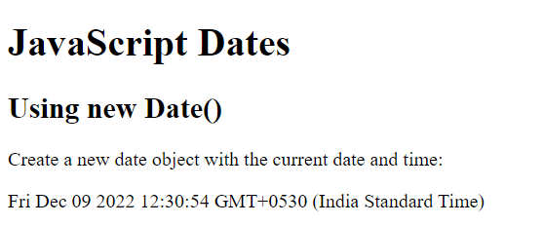
JavaScript Date Get Methods
<html>
<body>
<h1>JavaScript Dates</h1>
<h2>Using new Date()</h2>
<p>Create a new date object with the current date and time:</p>
<p id="demo"></p>
<script>
const d = new Date();
document.getElementById("demo").innerHTML = d;
</script>
</body>
</html>

Slide 40
JavaScript Set Date Methods
Set Date Methods
Set Date methods are used for setting a part of a date:
Method Description
setDate() →Set the day as a number (1-31)
setFullYear() →Set the year (optionally month and day)
setHours() →Set the hour (0-23)
setMilliseconds() →Set the milliseconds (0-999)
setMinutes() →Set the minutes (0-59)
setMonth() →Set the month (0-11)
setSeconds() →Set the seconds (0-59)
setTime() →Set the time (milliseconds since January 1, 1970)

Slide 41
JavaScript Set Date Methods
Example:
const d = new Date("2021-03-25"); d.getFullYear();
const d = new Date("2021-03-25"); d.getMonth();
const d = new Date("2021-03-25"); d.getDate();
const d = new Date("2021-03-25"); d.getHours();
const d = new Date(); d.setFullYear(2020);
const d = new Date(); d.setMonth(11);
const d = new Date(); d.setSeconds(30);

Slide 42
JavaScript Booleans
A JavaScript Boolean represents one of two values: true or false.
The Boolean() Function
We can use the Boolean() function to find out if an expression (or a variable) is true:
Boolean(10 > 9)
The Boolean value of an expression is the basis for all JavaScript comparisons and conditions.
let x = -0; Boolean(x);

Slide 43
JavaScript Booleans
<html>
<body>
<h2>JavaScript Booleans</h2>
<p>Display the value of Boolean(10 > 9):</p>
<p id="demo"></p>
<script>
document.getElementById("demo").innerHTML = Boolean(10 > 9);
</script>
</body>
</html>
Output:
true

Slide 44
JavaScript Numbers
JavaScript has only one type of number. Numbers can be written with or without decimals.
let x = 3.14; // A number with decimals
Extra large or extra small numbers can be written with scientific (exponent) notation:
let x = 123e5; // 12300000
let y = 123e-5 //0.00123

Slide 45
JavaScript Numbers – 64 Bit Floating Point
JavaScript numbers are always stored as double precision floating point numbers, following the international IEEE 754 standard
This format stores numbers in 64 bits, where the number is stored in bits 0 to 51, the exponent in bits 52 to 62 and the sign in bit 63.
Integer Precision:
Integers are accurate upto 15 digits
let x=999999999999999;
Floating Precision:
Floating Point arithmetic is not always 100% accurate.
let x=14.9;

Slide 46
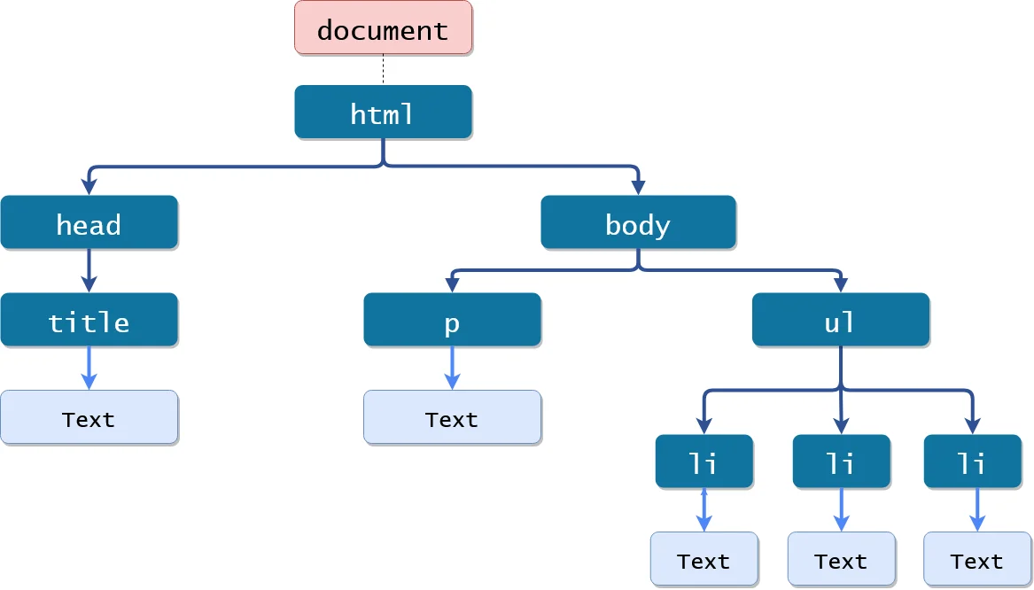
JavaScript Document Object Model
It is a programming interface that allows us to create, change, or remove elements from the document.
When a webpage is loaded, the browser creates a Document Object Model of the page.
The HTML DOM model is constructed as a tree of Objects.

Slide 47
Functions of JavaScript with DOM
JavaScript can change all the HTML elements in the page
JavaScript can change all the HTML attributes in the page
JavaScript can change all the CSS styles in the page
JavaScript can remove existing HTML elements and attributes
JavaScript can add new HTML elements and attributes
JavaScript can react to all existing HTML events in the page
JavaScript can create new HTML events in the page.

Slide 48
HTML DOM
The HTML DOM is a standard object model and programming interface for HTML.
HTML DOM is a standard for how to get, change, add, or delete HTML elements
The HTML elements as objects
The properties of all the HTML elements
The methods to access all HTML elements
The events for all the HTML elements

Slide 49
JavaScript Document Object Model
JavaScript Document object is an object that provides access to all HTML elements of a document.
When an HTML document is loaded into a browser window, then it becomes a document object.
The document object stores the elements of an HTML document, such as HTML, HEAD, BODY, and other HTML tags as objects.
A document object is a child object of the Window object, which refers to the browser.
What we can do with Document Object:
Suppose you have created a FORM in an HTML document using the FORM element and added some text fields and Buttons on the Form.
On Submitting the Form you want to validate the input or display input on another page.
In this situation, you can use a document object which is a child object of the window object. Using the document object, you can access the elements of the form and validate the Input.
The Document Object provides different collection elements, such as anchor and Links which helps you to count the number of specific elements on a form.

Slide 50
JavaScript Document Object
The Document Object also provides various properties such as URL, bgcolor, etc.
allow you to retrieve the details of a document and various methods such as open(), close(), write(), getElementById(), getElementByName(), etc.
allow you to perform various tasks like opening an HTML document to display output and writing a text on Web Page.
The Document Object also allows you to create cookies for a webpage by providing a property named cookie.
A cookie stores information about the user's computer, which helps in accessing visited websites.
JavaScript Document Object Properties
The property is accessed by using the following notation:
objectName.propertyName
where objectName is the name of the object and
propertyName is the name of its property.

Slide 51
Accessing the DOM
Use the API directly in JavaScript from within what is called a script, a program run by the browser
When you create a script, you can immediately start using the API for the document or window object to manipulate the document itself, or any of the various elements in the web page
DOM programming can be as simple as the following example, which displays a message on the console.
<body onload=“console.log(“Welcome to my home page”);”>
……….
</body>
It is not recommended to mix the structure of the page and manipulation of the DOM, the JavaScript parts will be grouped together here and separated from the HTML.

Slide 52
JavaScript Document Object
Properties Description
Cookie returns a report that contains all the visible and unexpired cookies associated with the document
Domain returns the domain name of the server from which the document has originated
lastModified returns the date on which document was last modified
documentMode returns the mode used by the browser to process the document
readyState returns the loading status of the document.
referrer returns the URL of the documents referred to in an HTML document
Title returns the name of the HTML document defined between the starting and ending tags of the TITLE element
URL returns the full URL of the HTML document.

Slide 53
Example - DOM
<!doctype html>
<head>
<style> /* CSS comes here */ </style>
<title>Document Properties</title>
</head>
<body>
<h3>Document Properties Example</h3>
<script>
document.write(document.cookie + “<br>”)
document.write(document.domain +"<br>")
document.write(document.lastModified +"<br>")
document.write(document.documentMode +"<br>")
document.write(document.title +"<br>")
document.write(document.url +"<br>")
</script>
</body>
</html>

Slide 54
JavaScript Document Object Methods
JavaScript Document object also provides various methods to access HTML elements.
open()→opens an HTML document to display the output
Syntax:document.open(mimetype, replace)
close()→closes an HTML document
Syntax:document.close()
write()→Writes HTML expressions or JavaScript code into an HTML document
Syntax:→document.write(exp1, exp2, ...)
writeln()→write a new line character after each HTML expressions or JavaScript Code
Syntax:document.writeln(exp1, exp2, ...)
getElementById()→returns the reference of first element of an HTML document with the specified id.
Syntax:→document.getElementById(id)

Slide 55
JavaScript Document Object Methods
getElementByName()→returns the reference of an element with the specified name
Syntax:→document.getElementsByName(name)
getElementsByTagName()→returns all elements with the specified tagname
Syntax:→document.getElementsByTagName(tagname)

Slide 56
Example - DOM
<!doctype html>
<head>
<title>JS Document Methods Example</title>
</head>
<body> <h3>Document Methods Example</h3>
<p id="demo">It Will change</p>
<script> // Open document
document.open(); // writing
document.write("Hello" +"<br>"); document.getElementById("demo").innerHTML = "Set by ID";
</script>
</body>
</html>

Slide 57
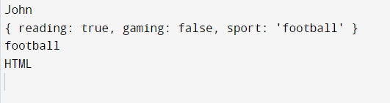
Using JSON to Represent objects
JavaScript Object Notation is a standard text-based format for representing structured data based on JavaScript object syntax.
It is commonly used for transmitting data in web applications
Example:
// JSON object
const data = {
"name": "John",
"age": 22,
"hobby": {
"reading" : true,
"gaming" : false,
"sport" : "football“
},
"class" : ["JavaScript", "HTML", "CSS"]}
console.log(data.name);
console.log(data.hobby);
console.log(data.hobby.sport);
console.log(data.class[1]);
<!DOCTYPE html>
<html>
<body>
<h2>Access a JavaScript object</h2>
<p id="demo"></p>
<script>
const myObj = {name:"John", age:30, city:"New York", hobby:{reading:"true",gaming:"false"},class:["Javascript","HTML","CSS"]};
document.getElementById("demo").innerHTML = myObj["class"][1];
</script>
</body>
</html>

Slide 58
Using JSON to Represent objects
<!DOCTYPE html>
<html>
<body>
<h2>Access a JavaScript object</h2>
<p id="demo"></p>
<script>
const myObj = {name:"John", age:30, city:"New York"};
document.getElementById("demo").innerHTML = myObj["name"];
</script>
</body>
</html>
Output:
Access a JavaScript Object
John

Slide 59
Using JSON to Represent objects
JSON object literals are surrounded by curly braces {}.
JSON object literals contains key/value pairs.
Keys and values are separated by a colon.
Keys must be strings, and values must be a valid JSON data type:
string
number
object
array
boolean
null
Each key/value pair is separated by a comma.
JSON cannot be an object. JSON is a string format.
The data is only JSON when it is in a string format. When it is converted to a JavaScript variable, it becomes a JavaScript object.

Slide 60
JavaScript Objects
We can create a JavaScript object from a JSON object literal:
JSON.parse() method parses a JSON string, constructing a JS value or object describing by the string.
const myJSON = '{"name":"John", "age":30, "car":null}’; const myObj = JSON.parse(myJSON);
Accessing Object Values
object values by using dot (.) notation:
const myJSON = '{"name":"John", "age":30, "car":null}'; const myObj = JSON.parse(myJSON); x = myObj.name;
Output:
John
Looping an Object
loop through object properties with a for-in loop:
In a for-in loop, use the bracket notation to access the property values:
const myJSON = '{"name":"John", "age":30, "car":null}'; const myObj = JSON.parse(myJSON); let text = ""; for (const x in myObj) { text += myObj[x] + ", ";
console.log(text); }
Output:
John,
John, 30,
John, 30, null,

Slide 61
Example - JavaScript Objects
<!DOCTYPE html>
<html>
<body>
<h2>Creating an Object from a JSON String</h2>
<p id="demo"></p>
<script>
const txt = '{"name":"John", "age":30, "city":"New York"}'
const obj = JSON.parse(txt);
document.getElementById("demo").innerHTML = obj.name + ", " + obj.age;
</script>
</body>
</html>
Output:
Creating an Object from a JSON String
John,30

Slide 62
Example - JavaScript Objects
<!DOCTYPE html>
<html>
<body>
<h2>Parsing a JSON Array.</h2>
<p id="demo"></p>
<script>
const text = '[ "Ford", "BMW", "Audi", "Fiat" ]';
const myArr = JSON.parse(text);
document.getElementById("demo").innerHTML = myArr[0];
</script>
</body>
</html>
Output:
Parsing a JSON Array
Ford

Slide 63
DOM: Objects and Collections
The HTMLCollection Object
The getElementsByTagName() method returns an HTMLCollection object.
An HTMLCollection object is an array-like list (collection) of HTML elements.
The elements in the collection can be accessed by an index number.

Slide 64
DOM: Objects and Collections
<html>
<body>
<h2>JavaScript HTML DOM</h2>
<p>Hello World!</p>
<p>Hello Norway!</p>
<p id="demo"></p>
<script>
const myCollection = document.getElementsByTagName("p");
document.getElementById("demo").innerHTML = "The innerHTML of the second paragraph is: " + myCollection[0].innerHTML;
</script>
</body>
</html>
Output:
JavaScript HTML DOM
Hello World!
Hello Norway!
The innerHTML of the second paragraph is Hello World!

Slide 65
DOM: Objects and Collections
<html>
<body>
<h2>JavaScript HTML DOM</h2>
<p>Hello World!</p>
<p>Hello Norway!</p>
<p>Click the button to change the color of all p elements.</p>
<button onclick="myFunction()">Try it</button>
<script>
function myFunction() {
const myCollection = document.getElementsByTagName("p");
for (let i = 0; i < myCollection.length; i++) {
myCollection[i].style.color = "red";
}
}
</script>
</body></html>
Output:
JavaScript HTML DOM
Hello World!
Hello Norway!
Click the button to change the color of all p elements
Try it

Slide 66
Event Handling
An Event is something that happens when user interact with the webpage, such as when we clicked a button, pressed a key on the board, moved the mouse pointer etc.
When JavaScript code is included in HTML, JavaScript react over these events and allow the execution. This process of reacting over the events is called Event Handling.
An HTML event can be something the browser does, or something a user does.
Here are some examples of HTML events:
An HTML web page has finished loading
An HTML input field was changed
An HTML button was clicked

Slide 67
Event Handling
HTML allows event handler attributes, with JavaScript code, to be added to HTML elements.
With single quotes:→<element event='some JavaScript'>
With double quotes:→<element event="some JavaScript">
Example
<b utton onclick="document.getElementById('demo').innerHTML = Date()">The time is?</button>
JavaScript code is often several lines long. It is more common to see event attributes calling functions:
Example
<button onclick="displayDate()">The time is?</button>

Slide 68
Example - Event Handling
<html>
<body>
<h2>JavaScript HTML Events</h2>
<p>Click the button to display the date.</p>
<button onclick="displayDate()">The time is?</button>
<script>
function displayDate() {
document.getElementById("demo").innerHTML = Date();
}
</script>
<p id="demo"></p>
</body></html>
Output:
JavaScript HTML Events
Click the button to display the time
Try it

Slide 69
Common HTML Events
Event Description
onchange An HTML element has been changed
onclick The user clicks an HTML element
onmouseover The user moves the mouse over an HTML element
onmouseout The user moves the mouse away from an HTML element
onkeydown The user pushes a keyboard key
onload The browser has finished loading the page

Slide 70
Common JavaScript Event Handlers
Event handlers can be used to handle and verify user input, user actions, and browser actions:
Things that should be done every time a page loads
Things that should be done when the page is closed
Action that should be performed when a user clicks a button
Content that should be verified when a user inputs data
And more ...
Many different methods can be used to let JavaScript work with events:
HTML event attributes can execute JavaScript code directly
HTML event attributes can call JavaScript functions
You can assign your own event handler functions to HTML elements
You can prevent events from being sent or being handled
And more ...

Slide 71
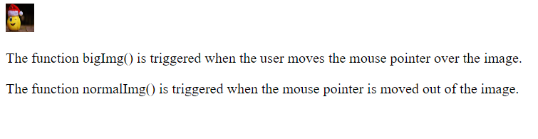
MouseOver Event
<html>
<body>
<img onmouseover="bigImg(this)" onmouseout="normalImg(this)" border="0" src="smiley.gif" alt="Smiley" width="32" height="32">
<p>The function bigImg() is triggered when the user moves the mouse pointer over the image.</p>
<p>The function normalImg() is triggered when the mouse pointer is moved out of the image.</p>
<script>
function bigImg(x) {
x.style.height = "64px";
x.style.width = "64px";
}
function normalImg(x) {
x.style.height = "32px";
x.style.width = "32px";
}
</script>
</body></html>

Slide 72
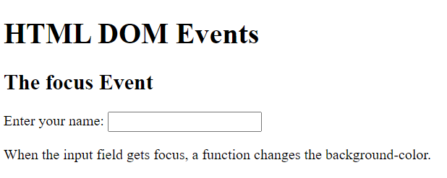
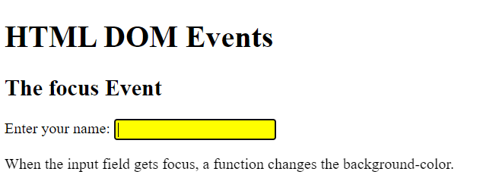
Focus Event
<html>
<body>
<h1>HTML DOM Events</h1>
<h2>The focus Event</h2>
Enter your name: <input type="text" onfocus="myFunction(this)">
<p>When the input field gets focus, a function changes the background-color.</p>
<script>
function myFunction(x) {
x.style.background = "yellow";
}
</script>
</body>
</html>

Slide 73
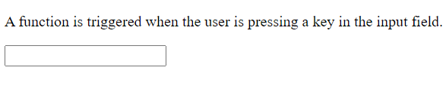
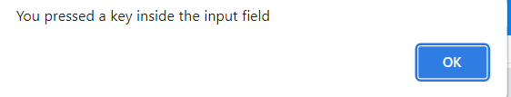
Keydown Event
<html>
<body>
<p>A function is triggered when the user is pressing a key in the input field.</p>
<input type="text" onkeydown="myFunction()">
<script>
function myFunction() {
alert("You pressed a key inside the input field");
}
</script>
</body>
</html>

Slide 74
Load event
<html>
<head>Javascript Events</head>
</br>
<body onload="window.alert('Page successfully loaded');">
<script>
document.write("The page is loaded successfully");
</script>
</body>
</html>
Output:
JavaScript Events
The page is loaded successfully

